Slide 1

Understanding
Lewy body
dementia

Slide 2

Lewy body dementia
Incidence, terminology
and aetiology

Slide 3
Lewy body dementia (LBD)
‘The most common disease
you have never heard of’
Second most common cause of neurodegenerative dementia
– 10-15% ^{1 & 2}
Approximately 100,000 people with LBD in UK
Lewy body dementia (LBD) includes both:
– Dementia with Lewy bodies (DLB) – 4-7.5% ¹
and
– Parkinson’s disease dementia (PDD) – 3.6- 9.7% ³
Dementia in Parkinson’s disease (PD)=30% overall ³
– 50% who live with PD>10 years ¹
– 80% who live with PD>20 years ¹
1 Vann-Jones & O’Brien, 2014; 2 Kane et al, 2018; 3 Aarsland et al, 2008

Slide 4
What is
dementia?
Dementia is the umbrella term for a group of symptoms that include a progressive loss of:
• Memory
• Judgement
• Reasoning
• Ability to communicate
• Ability to function
• Changes in mood and behaviour
Dementia
is a syndrome,
a group of related symptoms, associated with an on-going decline of the brain and its abilities

Slide 5
Main types of dementia
• Alzheimer’s disease (approx. 60%)
• Vascular dementia (approx. 20%)
• Lewy body dementia (approx. 10-15%)
• Mixed dementia
(usually Alzheimer’s
disease and vascular)
Lewy Body
Alzheimer’s
Vascular
…
Frontotemporal

Slide 6
…
Other types more likely to affect younger
people (i.e. people under the age of 65) include:
Fronto-temporal dementia (FTD) (approx. 5%)
– Behavioural variant (BvFTD)
– Primary progressive aphasia (PPA)
Posterior-cortical atrophy (PCA)
There are many other less common types e.g.
• Progressive Supranuclear Palsy (PSP) • CADASIL
• Huntington’s • HIV Corticobasal syndrome
• Normal Pressure Hydrocephalus • Niemann Type C

Slide 7
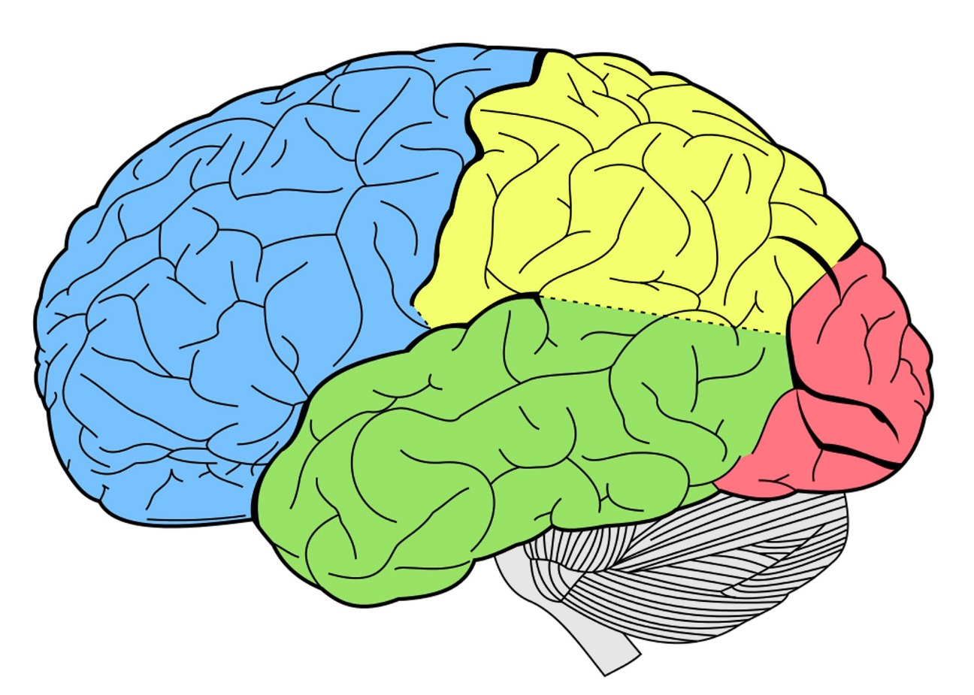
Dementia & brain function
Parietal lobe Supports awareness of our surroundings and coordination
Frontal lobe Involved in planning, solving problems and behaviour
Occipital lobe
Helps us interpret what we see
Temporal lobe Involved in memory, learning and understanding
Language
and speech
Cerebellum
Involved in balance and movement

Slide 8

Lewy
body
dementia
Terminology

Slide 9
Lewy body disease =
Parkinson’s disease (PD),
Parkinson’s disease dementia (PDD)
and
Dementia with Lewy bodies (DLB)
Dementia
With Ley Body (DLB)

Slide 10
Lewy body disease
Parkinson’s Disease
(PD)
PD Dementia
(PDD)
Dementia
with Lewy Bodies (DLB)
Lewy Body Dementia
(LBD)

Slide 11
Lewy body disease can spread through the brain
in different ways to cause either:
• Parkinson’s disease
• Dementia with Lewy bodies (DLB)
OR
• Parkinson’s disease dementia (PDD)
Lewy body dementia (LBD) symptoms can include:
Cognitive impairment, parkinsonism, visual hallucinations, fluctuating attention, REM Sleep behaviour disorder
• Alzheimer’s and Lewy pathologies frequently co-exist
and both may contribute to cognitive and neurological difficulties
• People with more than one pathology seem to have
more rapidly progressive symptoms and shorter survival

Slide 12
Mixed Pathology
Lewy body dementia can occur in people with ‘pure’ alpha-synuclein pathology but underlying pathology is often mixed
Presence of ß amyloid and tau neurofibrillary tangles (seen
in Alzheimer’s disease) leads to more advanced dementia
Parkinson’s disease dementia (PDD) – little evidence that cerebrovascular pathology contributes to cognitive impairment
Dementia with Lewy bodies (DLB) – contribution of cerebrovascular disease not established but cerebrovascular pathology often co-occurs with Alzheimer's disease
Genetics of Lewy body dementia:
• Most cases are sporadic • Rare autosomal inheritance may be linked
to mutations in SNCA & LRRK2 genes • Mutations in GBA may be a risk factor • APOE4 may increase risk but APOE2 may reduce risk
Walker et al, Lancet 2015

Slide 13
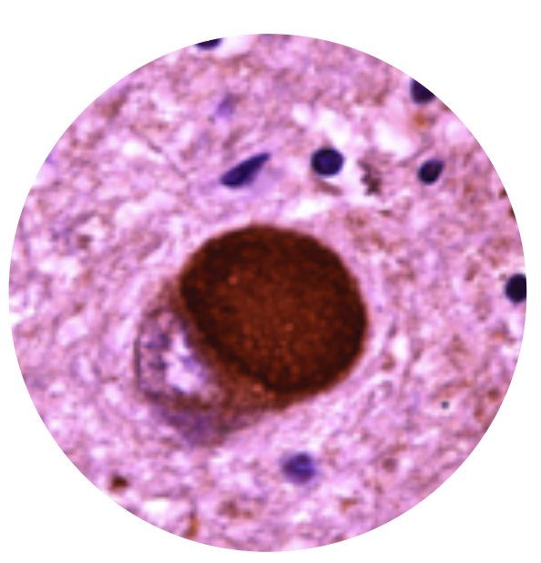
What are ‘Lewy bodies’?
Abnormal protein deposits that disrupt the brain's normal functioning – may originate in the peripheral nervous system
Discovered by Dr. Friederich Lewy,
German neurologist in 1912 in a Parkinson’s patient
Made up mostly of a protein called alpha-synuclein (also Tau, Synphilin-1, LRRK2)
Alpha-synuclein forms into clumps inside neurons, leading to:
• Change in function or death of neurons and
• Loss of production of neurotransmitters; acetylcholine and dopamine

Slide 14
Where are ‘Lewy bodies’ found?
Parkinson’s disease – usually found in mid brain and brain stem
Lewy body dementia – found in cerebral cortex and more diffusely
The midbrain and basal ganglia, which are involved in movement
The brain stem, important in regulating sleep and maintaining alertness
The cerebral cortex: important in information processing, perception, thought, and language
The limbic cortex, plays a major role in emotions and behaviour
The hippocampus, essential to forming new memories
Brain regions important in recognising smells (olfactory pathways)

Slide 15
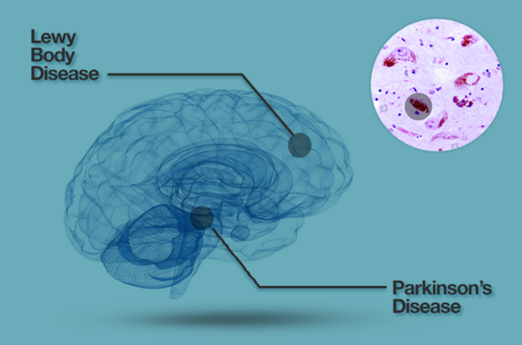
Parkinson’s UK

Slide 16
Parkinson’s & Lewy bodies
What causes Parkinson’s (click to watch short animation)
Loss of dopamine cells in:
• Substantia nigra in the mid-brain leads to:
Motor symptoms: tremor, slowness of movement & rigidity
• ‘Brain stem’ may lead to:
Non – motor symptoms: hypotension, fatigue, bladder/bowel dysfunction, excess sweating, eating/swallowing/saliva control,
sleep problems, speech etc.
Lewy bodies and Parkinson’s?
Aggregation & transmission of alpha-synuclein between cells in
brain is involved in Parkinson’s, but may not be cause of cell death
• Further research underway
Information from Parkinson’s UK

Slide 17

Lewy body dementia
Presentation,
symptoms
and progression

Slide 18
Lewy body dementia
The ‘one year rule’¹
Parkinson’s disease dementia:
Dementia starting 1 year or more after well established
Parkinson’s disease
Dementia with Lewy bodies:
Dementia that occurs before or concurrently with parkinsonism
or within 1 year of onset of motor symptoms
1. McKeith et al, 2005

Slide 19
Revised criteria for DLB
Cognitive decline
and dementia
Fluctuating level
of consciousness
Visual hallucinations
Parkinsonism:
tremor, rigidity,
gait problems
REM sleep
behaviour disorder
DLB
Autonomic dysfunction
Neuropsychiatric features
Other supportive features e.g. hyposmia, hypersomnia, falls
Pink = essential for diagnosis Blue = core clinical features Black = supportive features
McKeith et al, Neurology 2017

Slide 20
Symptoms – in more detail
Cognitive impairment - attention, executive function and visual-perceptual functions are disproportionately affected, compared with naming & memory abilities
Cognitive fluctuations – core clinical feature – (in approx. 90% of people) – changes in alertness or attention affecting functional ability can be spontaneous, periodic and transient
Sleep disturbance – can be severe and include insomnia, sleep fragmentation, rapid eye movement (REM) sleep behaviour disorder, restless legs syndrome, sleep apnoea, excessive daytime somnolence (sleepiness)
• REM Sleep Behaviour disorder (RBD) – core clinical feature
(in up to 75% of people) – dream enactment involving movement of limbs. Can precede diagnosis of Parkinson’s and LBD by
many years
Taylor et al 2019, Walker et al 2015

Slide 21
Symptoms – in more detail
Neuropsychiatric features
Visual hallucinations: core clinical feature – (in approx. 75% of people). Usually visual and recurring – often images of people, animals or objects and more common in the evening or night
Delusions: may be linked to hallucinations and often have a theme (systemised). Delusions
of misidentification (Capgras syndrome), theft or infidelity
are common and can be very distressing for families
Depression: more frequent in LBD than AD; may be exacerbated by increased insight into diagnosis and complex symptoms
Apathy: diminished initiative, motivation and affect – common problem and can be very difficult for families
Anxiety: also common and may accompany depression. May occur as a result of other symptoms such as cognitive difficulties, hallucinations etc.
Taylor et al 2019, Walker et al 2015

Slide 22
Symptoms – in more detail
Motor symptoms (Parkinsonism) – core clinical feature in PDD
(in DLB present in less than half at diagnosis and possibly never in 25%)
Tremor Usually in the hands – most commonly at rest or on movement (kinetic)
Rigidity Muscle stiffness, freezing (lower half of body feels ‘stuck’), postural instability/gait problems (difficulty with balance and gait)
Bradykinesia Slowness or reduction of spontaneous movement
Facial expression Masked expression, decreased eye blinking, less movement around the mouth
Differences in motor symptoms
for people with PDD and DLB:
PDD Tremor, rigidity, postural instability and bradykinesia
are more common and often
more severe
DLB Parkinsonism in DLB requires the presence of at least one of
the following: bradykinesia, rest tremor or rigidity.
Problems with rigidity and balance more common – tremor less frequent
Taylor et al 2019, Walker et al 2015

Slide 23

…
Other motor symptoms can include problems with:
• Risk of falls – due to poor balance, orthostatic hypotension & frailty
• Muscle cramps & dystonia – painful contraction of muscles
• Restless legs – urge to move legs
when resting
• Swallowing – reduction in frequency,
poor swallow reflex
• Speech – less fluent and quieter volume

Slide 24
…
Autonomic dysfunction – (dysautonomia)
Range of symptoms controlled by autonomic nervous system – common in Parkinson’s disease – may be associated with more rapid disease progression in DLB
Orthostatic hypotension
Poor regulation of blood pressure leading to a ‘postural drop’ in blood pressure when standing or changing position, causing dizziness
Gastrointestinal dysfunction
Can include gastroparesis (slowing
of gut motility), sialhorrea (excess saliva),constipation
Urinary dysfunction
common problem including urgency, frequency and incontinence, particularly
at night (nocturia)
Excess sweating (hyperhidrosis)
may be linked with fluctuations in motor symptoms – reported by 2/3rds of people with Parkinson’s
Changes in or loss of smell (hyposmia/anosmia)
may be a feature in Parkinson’s but can be present in LBD

Slide 25
Clinical features: DLB v PDD Jellinger 2018
Major clinical features | Dementia with Lewy bodies (DLB) | Parkinson’s disease dementia (PDD)
Cognitive impairment | Deficits on attention, executive function and visuospatial ability. Memory impairment less prominent at onset but increasing in later stages Faster rate of decline than AD | Impairment of more than one domain; some changes similar to DLB e.g. executive dysfunction, others are different (attention, episodic verbal memory)
Fluctuating cognition | Marked variation in alertness and attention | If present, similar to DLB
Hallucinations | Recurrent, most often visual, well formed (e.g. people, animals) | Present after Levodopa therapy
Motor parkinsonism | Usually absent before dementia occurs, tremor uncommon or absent | Variable akinesia, rigidity, tremor frequent
REM Sleep disorder | May precede DLB for many years OR develop later | Same as DLB
Non-motor symptoms | Day time sleepiness, transient episodes of unresponsiveness, neuroleptic sensitivity, urine incontinence, constipation, falls, hyposmia, depression, apathy, anxiety | Changes in mood and behaviour similar to DLB Neuroleptic sensitivity less frequent

Slide 26
Prodromal features of
Dementia with Lewy bodies (DLB)
a-synuclienopathy
Lewy body disease
PATHOLOGICAL
RBD
MSA
PD PDD
DLB
CLINICAL
PRODROMAL
SYNDROMAL
1. McKeith et al, Neurology 2020

Slide 27

…
RBD (REM Sleep Behaviour Disorder) may occur several years before onset of Dementia with Lewy bodies or Parkinsonism
Prodromal phase of DLB thought to include one or more of the following: ¹
1. MCI (Mild cognitive impairment)
2. Recurrent delirium
3. Psychiatric symptoms e.g. hallucinations,
systemised delusions etc.
1. McKeith et al, Neurology 2020

Slide 28
Survival analysis of Dementia with Lewy bodies (DLB) compared with Alzheimer’s Disease (AD)
Survival analysis accounting for age, antipsychotic prescribing and frailty
AD survival:
6.7 years for males
and 7.0 years for females
DLB survival:
3.3 years for males
and 4.0 years for females
Price et al, BMJ Open, 2017

Slide 29

Lewy body dementia
Delirium v
Dementia with
Lewy bodies

Slide 30
Delirium & Dementia with Lewy bodies (DLB)
People with dementia: Increased risk of developing delirium
People with repeated delirium: Increased risk of
developing dementia
Delirium: Common symptom in early stages of ‘Dementia
with Lewy bodies’ (DLB) (may be a prodromal feature)
Delirium and LBD: global impairment of cognition, ﬂuctuations in attention and perceptual abnormalities
Can be difficult to differentiate – however slight differences
in presentation
Gore, Vardy & O’Brien, 2014

Slide 31
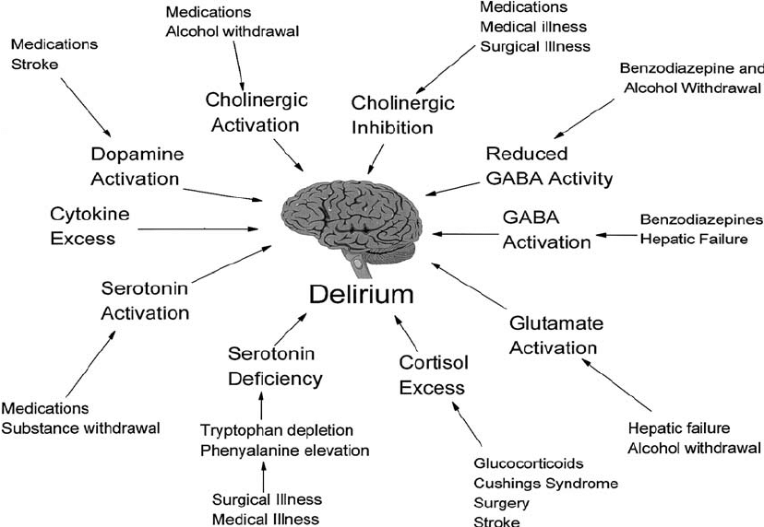
Delirium & Dementia with Lewy bodies (DLB)
Delirium is caused by multifactorial pathophysiology but can include changes in acetylcholine and dopamine
Acetylcholine – deficiency in both people with delirium and DLB (less clear in PDD)
Dopamine – excess in delirium rather than a deficit (as in LBD)
Pathophysiology of delirium. The evidence supports multiple mechanisms
of delirium, which may pertain in different clinical situations. [Reproduced from Flacker and colleagues. J Gerontol Biol Sci. 1999;54A:B239–B246]

Slide 32
Delirium and DLB – overlap and differences
 | Delirium | DLB
Onset | Acute | Gradual & progressive
Cognitive impairment | Fluctuating attention, Executive function, memory, visuospatial deficits | Fluctuating attention, some executive function, working memory, visuospatial deficits & vigilance
Perceptual disturbances | Visual and auditory hallucinations, delusions | Recurrent structured visual hallucinations, delusions
Sleep–wake cycle | Disturbance in sleep-wake cycle | REM sleep behaviour disorder
Consciousness | Fluctuating | Transient loss
Motor signs | Hyperactive and/or hypoactive Risk of falls | Parkinsonism Repeated falls
Syncope (fainting) | Not reported | Present
Neuroleptic sensitivity | Some symptoms responsive to neuroleptics | Severe neuroleptic sensitivity in some
Gore, Vardy & O’Brien, 2014

Slide 33

Lewy body dementia
Assessment
and diagnosis

Slide 34
Under-diagnosis of Lewy body dementia (LBD)
Lewy body dementia (LBD): estimated 10-15% of all dementias
(second most common neurodegenerative dementia)
• Dementia with Lewy bodies (DLB) – 4-7.5% ¹
• Parkinson’s disease dementia (PDD) – 3.6-9.7% ²
BUT diagnosis & recognition is poor:
• DLB often misdiagnosed as Alzheimer's disease³
• Multiple visits before correct diagnosis⁴
• In DLB – lack of assessment of key features
i.e. hallucinations, sleep disorder, movement disorder
• In PDD symptoms attributed to medication,
cognition not assessed or value of diagnosis not recognised
¹ Vann-Jones & O’Brien 2014; ² Aarsland et al, 2008; ³ McKeith 2006
⁴ Galvin et al 2010

Slide 35
Longer and more complex pathway to Lewy body dementia diagnosis
Time from referral to diagnosis significantly longer for Dementia
with Lewy bodies (DLB) than for non-DLB dementia (376 v 177
days, p=0.02)
People with DLB had more clinical contacts, both prior to
diagnosis (8 v 3, p < 0.01) and in total (20 v 3.5)
46% people with DLB previously received another dementia
diagnosis compared to 13% non- DLB (p < 0.001), often
Alzheimer’s disease or mixed dementia
Evidence of diagnostic delays in Parkinson’s disease dementia
(PDD); people on anti-dementia drugs >1.5 years before
dementia diagnosis
Surendranathan et al 2020 BJ Psych Open

Slide 36
Assessment and diagnosis of Dementia
with Lewy bodies (DLB)
Evidence of cognitive impairment of sufficient magnitude to interfere with normal social and occupational function
Core features (need two or one + biomarker for probable DLB)
• Fluctuating cognitive impairment – 80%
• Recurrent complex visual hallucinations – 70%
• Spontaneous features of parkinsonism – 25-50% (75% eventually)
• REM Sleep Behaviour Disorder (RBD)
Indicative biomarkers
• Low dopamine transporter uptake in basal ganglia demonstrated
by SPECT, PET imaging or DAT scan
• Abnormal cardiac MIBG myocardial scintagraphy imaging
• RBD confirmed by polysomnography
McKeith et al (2017) Neurology

Slide 37

Assessment and diagnosis of
Dementia with Lewy bodies (DLB)
Supportive clinical features
• Neuroleptic (antipsychotic) sensitivity
• Postural instability
• Repeated falls
• Syncope or transient episodes
of unresponsiveness
• Severe autonomic dysfunction
• Hypersomnia
• Hyposmia
• Hallucinations in other modalities
• Systematized delusions
• Apathy
• Anxiety
• Depression

Slide 38
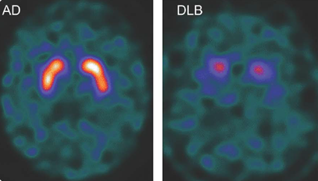
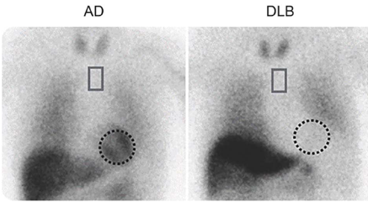
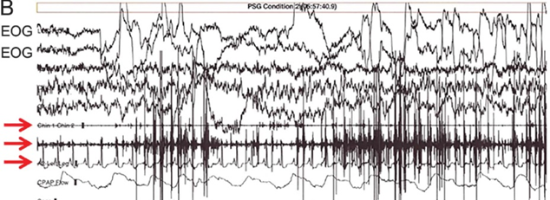
Criteria for Dementia
with Lewy bodies
Indicative biomarkers
• Low dopamine transporter uptake
in basal
• Abnormal cardiac MIBG imaging
• Polysomnography confirmed REM
Sleep Behaviour Disorder (RBD)
McKeith et al, Neurology, 2017

Slide 39
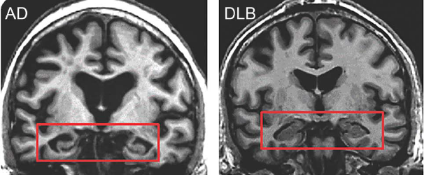


Assessment and diagnosis of
Dementia with Lewy bodies (DLB)
Supportive biomarkers
• Preservation of medial temporal lobe on structural imaging
• Abnormal perfusion SPECT/metabolic (FDG) PET with occipital changes and/or “cingulate island sign”
• Prominent posterior slow wave activity on EEG with periodic fluctuations
DLB
AD
McKeith et al, Neurology, 2017

Slide 40

Diagnosing Dementia with Lewy bodies (DLB)
  If the diagnosis is uncertain and dementia with Lewy bodies
  is suspected, use ¹²³I-FP-CIT SPECT
  If ¹²³I-FP-CIT SPECT is unavailable, consider ¹²³I-MIBG cardiac scintigraphy
  Do not rule out dementia with Lewy bodies based solely on normal results on ¹²³I-FP-CIT SPECT or ¹²³I-MIBG cardiac scintigraphy
NICE Dementia Guideline, June 2018

Slide 41



DIAMOND-Lewy Programme
1. How often is Lewy body dementia currently diagnosed and how is it managed?
2. What are the barriers and facilitators to diagnosing
and managing LBD?
4. What are the best ways
to diagnose LBD?
3. What are the best evidence based ways to manage LBD?
PPI
5. Trial: Can the toolkits be introduced into busy clinical services and does the management toolkit have any effect on outcomes for patients and carers?
1R. Does the introduction of better diagnostic methods (assessment toolkit) increase LBD diagnostic rates?

Slide 42
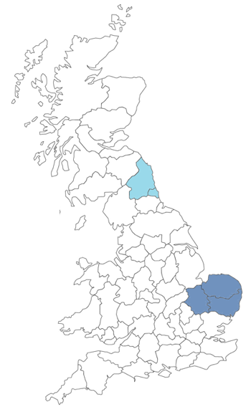
DIAMOND-Lewy
Programme
North East
East Anglia

Slide 43
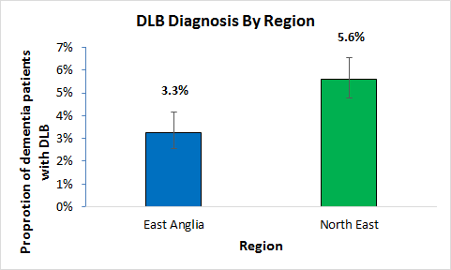
Results – frequency of DLB diagnosis
• 9449 consecutive patients in 9 NHS services
• 4.6% of dementia subjects were diagnosed with
• DLB across both regions
DLB prevalence was significantly higher in
the North East (p<0.01)
• Significant variation between services (p<0.05)
Kane et al, ART, 2018

Slide 44
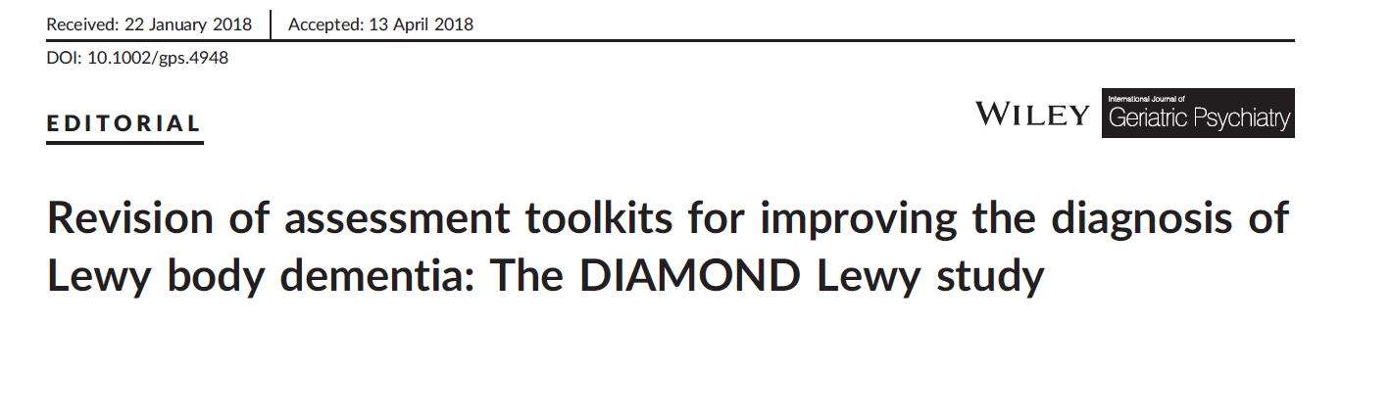
Two assessment toolkits:
One for use in memory services (DLB)
Just type DIAMOND Lewy into a search engine
https://research.ncl.ac.uk/diamondlewy/
Toolkits + Assessment Video (click on link to watch video)
Thomas et al, 2016 & 2018

Slide 45
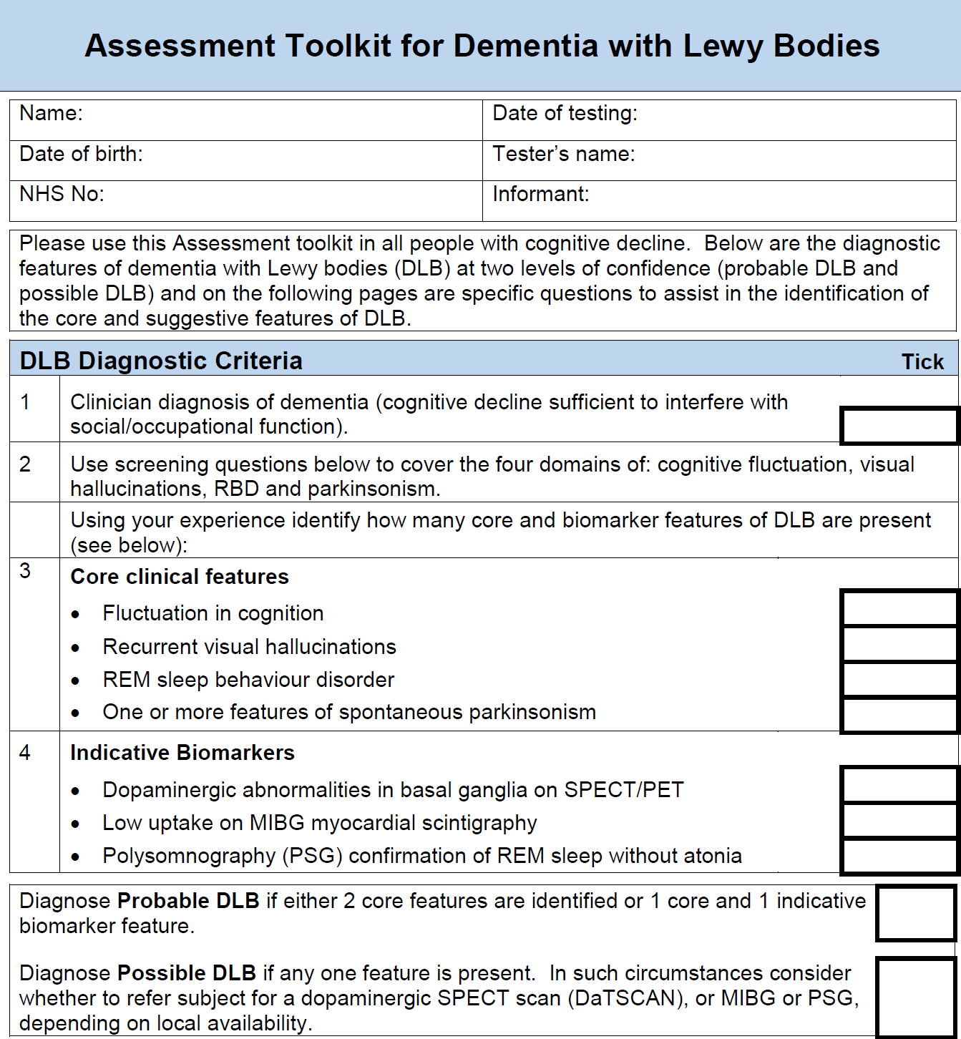
Better diagnosis
of Dementia with Lewy bodies (DLB): assessment toolkits to improve diagnosis
Overview of
symptoms and investigations
required to confirm possible or probable diagnosis of DLB

Slide 46
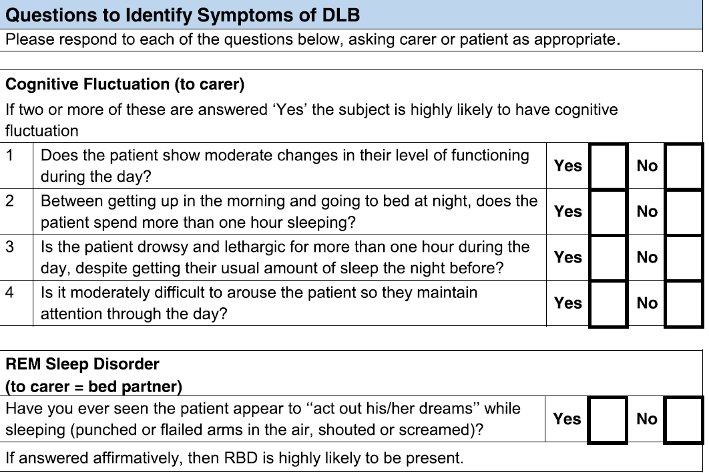
Questions to help identify core clinical features

Slide 47
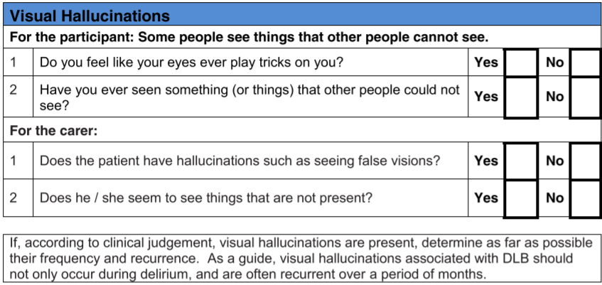
Tip: Include a specific question about hallucinations as
the person may not
offer this information
without prompting

Slide 48
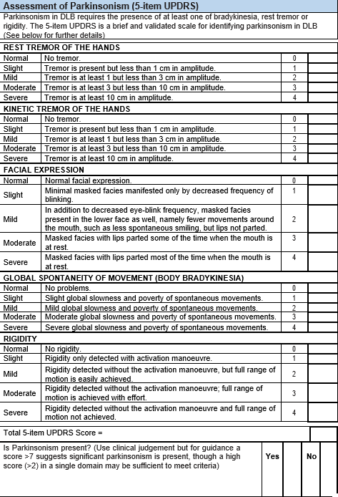
Tip: Motor symptoms may
be observed throughout the assessment but specific assessment of movement may also be required

Slide 49
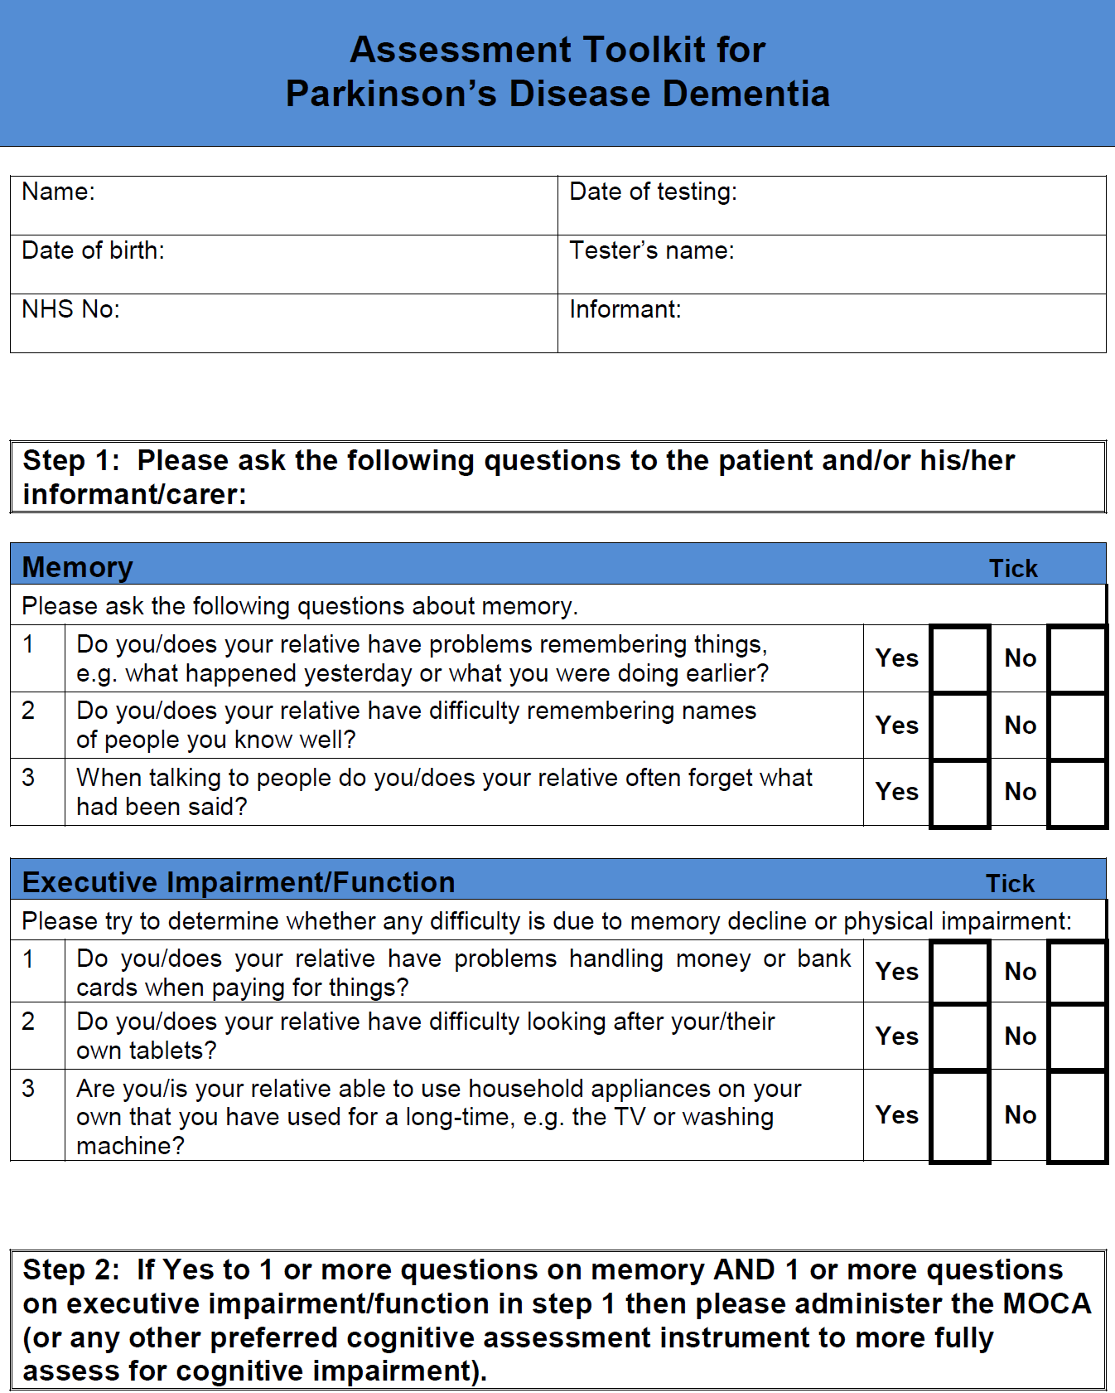
Assessment Toolkit for
use in medical/neurology/ movement disorder services
For Parkinson’s Disease dementia (PDD) and Dementia with Lewy bodies (DLB)
Tip: Cognitive
assessment should include assessment of visual – spatial impairment
Questions
used to help identify cognitive impairment

Slide 50
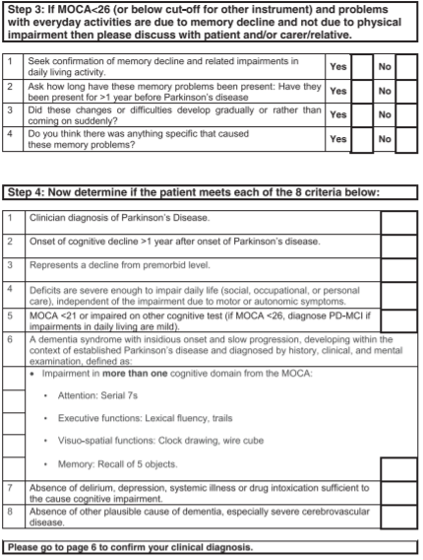
Determining differential diagnosis between PDD, DLB and ruling out delirium
Summary of symptoms to help confirm diagnosis

Slide 51
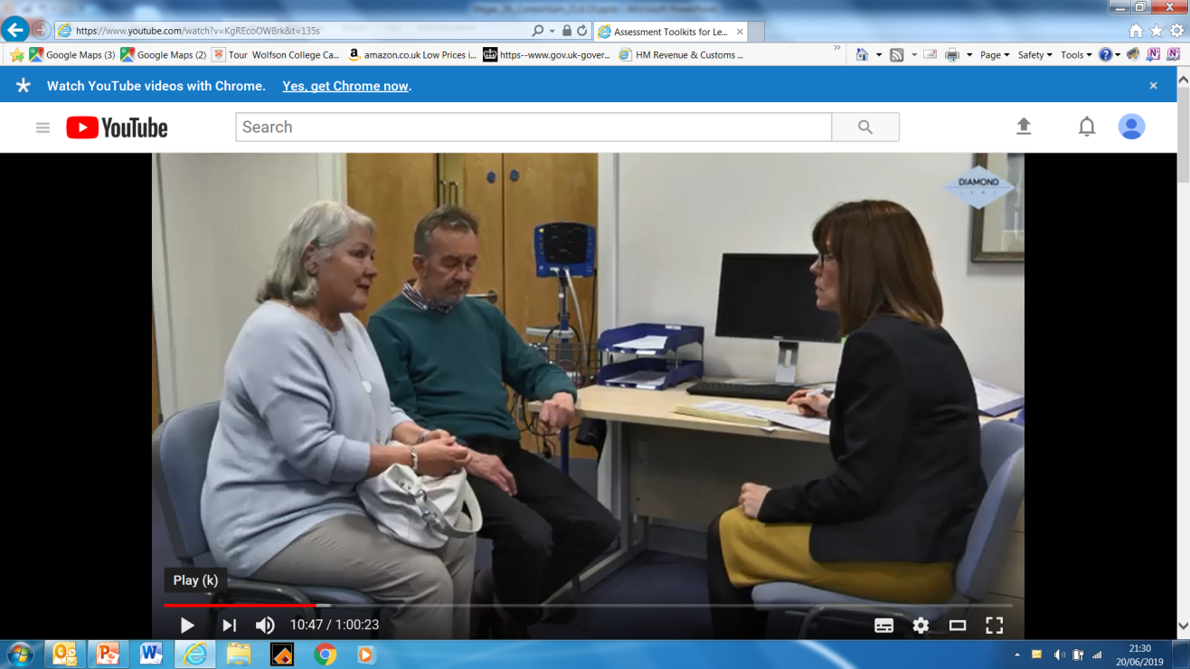
Video assessment toolkits
Assessment for Dementia with Lewy bodies and Parkinson’s disease dementia (click on link to play)
Includes assessment of fluctuations, hallucinations, cognition and Parkinsonism

Slide 52
Lewy body dementia
Management
and treatment

Slide 53
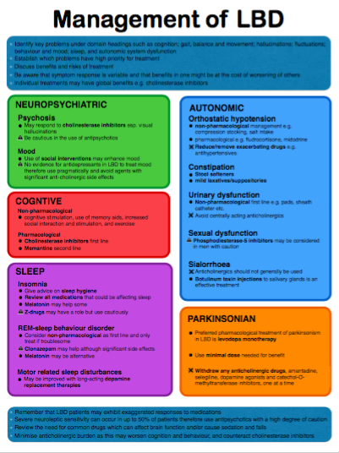
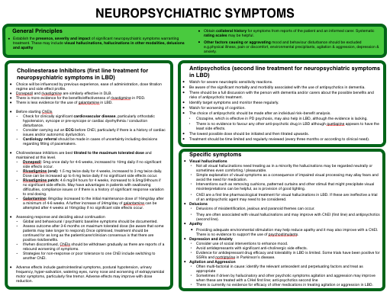
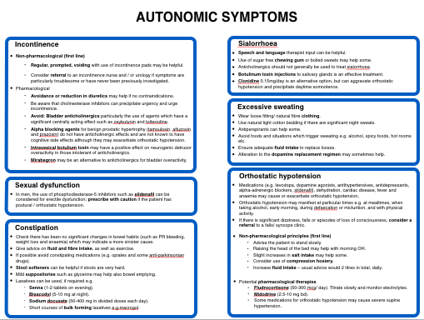
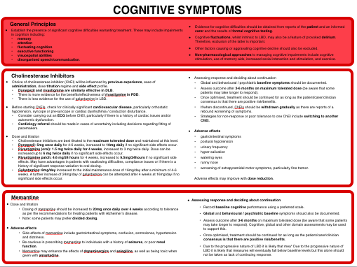
Diamond Lewy Management Toolkit
LBD
Management
Toolkit
The LBD management toolkit includes:
• Management overview – major symptoms in
Lewy body dementia and their management
• Symptom management summaries – one page
summaries for key symptoms (cognitive,
neuropsychiatric, motor, autonomic and sleep)
• Reference guidelines – detailed
recommendations on the management
of Lewy body dementia

Slide 54
Treatment and support
Pharmacological & non-pharmacological
• Identify key problems under domain headings such as cognition; gait, balance and movement; hallucinations; fluctuations; behaviour and mood; sleep, and autonomic system dysfunction
• Establish which problems have a high priority for treatment
• Discuss benefits and risks of treatment
• Be aware that symptom response is variable and that benefits in one might be at the cost of worsening of others
• Individual treatments may have global benefits e.g. cholinesterase inhibitors
• Refer to relevant therapist for specific
treatment e.g. physiotherapist,
occupational therapist (OT), Speech and
Language therapist (SLT)
Cognitive
Non-pharmacological
• Cognitive stimulation, use of memory aids, increased social interaction and stimulation, and exercise
Pharmacological
• Cholinesterase inhibitors first-line
• Memantine second line
Cholinesterase
inhibitors: (Rivastigmine*/Donepezil)
Memantine (NDMA)–
may be used as
monotherapy or
combined)
* Favoured in PDD

Slide 55
Pharmacological management of DLB
Offer donepezil or rivastigmine to people with mild to moderate dementia with Lewy bodies
Consider donepezil or rivastigmine for people with severe dementia with Lewy bodies
Consider memantine for people with dementia with Lewy bodies if AChE inhibitors are not tolerated or are contraindicated
NICE Dementia Guideline, June 2018

Slide 56
Management of neuropsychiatric symptoms
Psychosis
• May respond to cholinesterase inhibitors especially visual hallucinations.
• Be cautious in the use of antipsychotics
Mood
• Use of social interventions may
enhance mood.
• No evidence for antidepressants in LBD
to treat mood therefore use pragmatically and avoid agents with significant
anti-cholinergic side effects.
Anxiety/depression
• Use of psychological/social interventions
• No evidence for antidepressants in LBD – (may worsen REM sleep disorder)
• Avoid anti-cholinergic agents
• Possible use of ECT, rTMS (Repetitive Transcranial Magnetic Stimulation
and DBS (Deep Brain Stimulation)
Hallucinations/delusions
• Consider use of non-pharmacological interventions e.g. environment, music etc.
• Consider reduction of Levodopa medications
• 50% of people have severe neuro-sensitivity
• Possible use of quetiapine or clozapine
• Trials underway for pimavanserin and ondansetron

Slide 57
Management of sleep problems
Insomnia/excessive daytime sleepiness
• Give advice on sleep hygiene
• Review all medications that could be affecting sleep
• Melatonin may help some
• Z-drugs (e.g. zopiclone & zolpidem)
may have a role but use cautiously
REM-sleep behaviour disorder
• Consider non-pharmacological as first- line (i.e. decreasing risk of harm to self/
others) and only treat if troublesome
• Clonazepam may help although significant side effects
• Melatonin may be alternative
Motor related sleep disturbances
• May be improved with long-acting levodopa
• Extra pyramidal symptoms may be improved using long-acting levodopa
prior to going to bed
Restless legs syndrome (RLS)
• Consider other factors e.g. diabetes, anaemia – check ferritin levels
• Regular exercise
• Pharmacological treatments with
caution e.g. dopamine replacement,
gabapentin

Slide 58
Management of autonomic symptoms
Orthostatic hypotension
• Non-pharmacological management
e.g. compression stockings, fluid/salt intake, stand slowly etc.
• Pharmacological
e.g. fludrocortisone, midodrine
• Reduce/remove exacerbating drugs
e.g. antihypertensives
• Some medications may exacerbate
e.g. levodopa, dopamine agonists, antihypertensive, antidepressants etc.
• May occur at specific times – monitor
Constipation
• Stool softeners
• Mild laxatives/suppositories
• Check for other causes and symptoms
• Advise on diet, exercise etc.

Slide 59
…Management of autonomic symptoms
Urinary dysfunction
• Non-pharmacological first-line e.g. pads, sheath catheter etc.
• Avoid centrally acting anticholinergics
Urinary incontinence
• Nocturia (night time) – significant issue
• Avoid anti-muscarinics
• Cholinesterase inhibitors can precipitate urgency
• Medications for overactive bladders may be tried e.g. mirabegron

Slide 60
….Management of autonomic symptoms
Gastroparesis
• Avoid using metoclopramide
• Domperidone can be used but is cardiotoxic
• Slow gastric emptying can lead to fullness, reflux, belching
• Dopaminergic drugs can exacerbate symptoms
Sialorrhoea (excessive drooling)
• Anticholinergics should not generally be used
• Botulinum toxin injections to salivary glands is an effective treatment
• Linked to dysphagia
• Possible use of honey-thickened fluids
Excessive sweating
• Identify triggers and modify environment
Sexual dysfunction
• Phosphodiesterase-5 inhibitors may be considered with caution in men

Slide 61
Management of motor symptoms
• Preferred pharmacological treatment of parkinsonism in Lewy body dementia
is levodopa monotherapy
• Use minimal dose needed for benefit
• Withdraw in order, one at a time: anticholinergic drugs, amantadine, selegiline,
dopamine agonists and catechol-O-methyltransferase inhibitors
Dementia with Lewy bodies - General:
• Identify problematic motor difficulties (resting tremor is less prevalent in DLB).
• N.B Parkinsonian symptoms may be less responsive to treatment than in Parkinson’s
Treatment
• Preferred treatment: levodopa monotherapy
• Side effects may include: psychosis, postural hypotension, nausea etc.
Parkinson’s disease dementia - General:
• Consider optimisation of Parkinson’s
medication
Treatment
• Gradual simplification or reduction of
antiparkinsonian medication often necessary to balance neuropsychiatric symptoms vs motor benefits

Slide 62
….Management of motor symptoms
Both Dementia with Lewy bodies & Parkinson’s disease dementia
• Vitamin D may be considered due to falls risk
• Physiotherapy may help with freezing of gait, balance,
strength/flexibility and help reduce falls
• Occupational therapy to maintain independence and
reduce falls
• Consider Speech and Language therapy for speech
& swallowing problems

Slide 63
Lewy body dementia
Research –
future direction
and priorities

Slide 64

Research developments in dementia
• Investment in dementia research has increased but….
• Most dementia research has focused on Alzheimer’s disease
• Research on disease modifying treatments continues but
is expensive and takes a number of years
• Focus continues on prevention & reducing risk

Slide 65

Join Dementia Research
• Join Dementia Research is a nationwide service that
helps anyone in the UK take part in vital dementia
research studies
• Brings together current research studies in dementia
in one place
• Ongoing research aims to increase understanding of
dementia, improve diagnosis, treatment and identify
the best possible care
• People with Lewy body dementia are currently
under-represented
www.joindementiaresearch.nihr.ac.uk

Slide 66
Research priorities for Lewy body dementia
Parkinson’s UK lists the top 10 priorities as set out by the
James Lind Alliance Priority Setting Partnership
• Policies affecting grants | Parkinson's UK (parkinsons.org.uk)
• Parkinson's Top 10 priorities | James Lind Alliance (nihr.ac.uk)
James Lind Alliance Priority Setting Partnership also identifies
the top priorities for dementia research:
• Dementia Top 10 | James Lind Alliance (nihr.ac.uk)
For further information about emerging research in Lewy body dementia See: https://www.lewybody.org/research/lbs-research/

Slide 67
Future directions for improving the
management of Lewy body dementia
Symptomatic therapies, for example, focusing on neurotransmitter modulation
Potential disease modifying therapies
Targeting early-stage disease e.g. people with Lewy body disease and mild cognitive impairment; REM sleep behaviour disorder
Non-pharmacological interventions e.g. psychological interventions, gait training, non-invasive brain stimulation
Repurposing drugs from other diseases
Developing new and accurate diagnostic tests which are both sensitive and specific for early disease detection

Slide 68
Lewy Body Society – supporting research
Member of the AMRC (Association of Medical Research Charities)
– membership organisation dedicated to supporting medical research charities in saving and improving lives through research
and innovation
In the last 15 years the society has provided £1.8million worth
of funding for research projects that are changing the lives of
people with Lewy body dementia across the UK
Lewy Body Society research is working towards earlier diagnoses,
more targeted treatments and a better understanding of the
causes of the disease and its impact on individuals
Information about applying for grants can be found here: https://www.lewybody.org/research/lbs-research-strategy/

Slide 69
Lewy body dementia
Supporting families

Slide 70

Living with Lewy body dementia:
A short film
Living with Lewy body dementia (click on link to watch)

Slide 71
Lewy body dementia
Challenges for families
Difficulty with getting a diagnosis/
differing symptoms (Walker et al 2015)
Poor understanding/recognition by professionals (Thomas et al 2016)
Poorer quality of life & well being
(IDEAL study, Clare et al 2019, Wu et al 2018)
Family carers: higher stress levels
(Lee et al 2013, Leggett et al 2010)
Numerous and complex/troublesome symptoms
(Taylor et al 2018, Ballard et al 2013, Aarsland et al 2004)
Medication risks/contra-indication’s – severe reaction to antipsychotics in 50%
(Taylor et al 2018)
Lack of information/post diagnostic support (Killen et al 2015)
Poorer prognosis (Rongve et al 2016,
Price et al 2017)
Increased hospitalisation & poorer outcomes (Mueller et al 2018)
Poor co-ordination of care
(Galvin et al 2010)
Families not receiving timely support and information
(Bentley et al 2020)

Slide 72
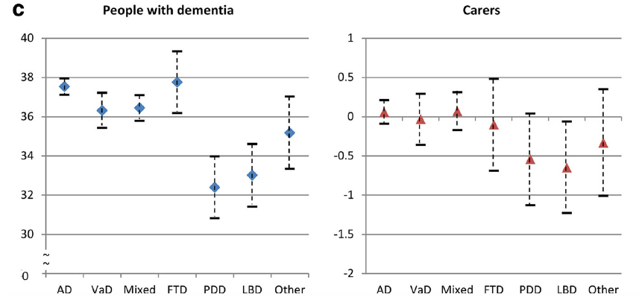
Low quality of life in Lewy body dementia
Wu et al, 2018

Slide 73
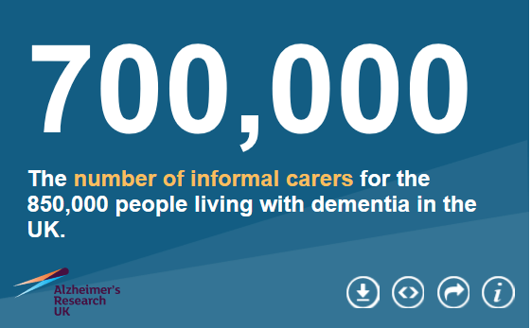
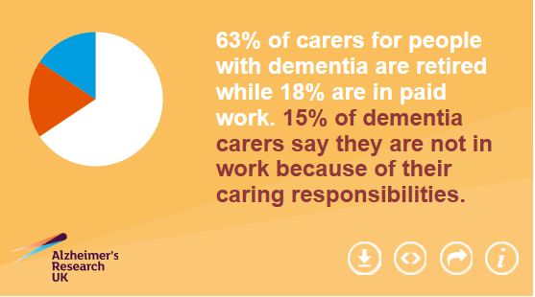

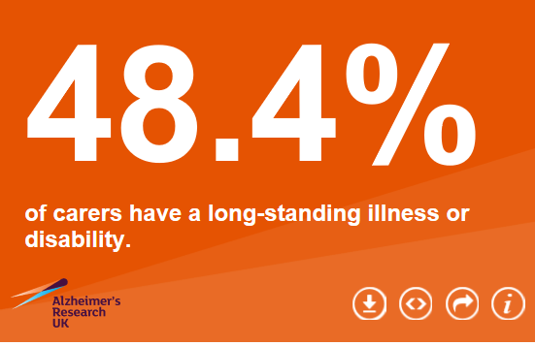
Recognising family carers’ needs
https://www.dementiastatistics.org/statistics/impact-on-carers/

Slide 74

Why support family caregivers?
• Prevalence of depression among carers of people with dementia is estimated at between 40-60%
(Redinbaugh et al 1995, Chan et al 2013)
• Caregivers of people with dementia have higher stress levels than other caregivers
(Rosenvinge et al 1998)
• Behaviour disturbance and high level of neuropsychiatric disturbance is the most
consistent predictor of carer burden
(Coen et al 1997, Sink et al 2006, Gallagher et al 2011,
Chiao et al 2015)
Even at early stages of cognitive impairment spouses assume the role of family caregiver and can experience both caregiver burden and psychiatric morbidity associated with the role. (Nolan 2001)

Slide 75
“
^{The stresses}
^{or difficulties of}
^{caring are best understood}
^{from a subjective rather}
than an objective perspective, with the circumstances
^{of care being less important}
^{than a carer’s perception}
^{of them.}
^{Nolan 2001}
”

Slide 76
Understanding caregiving
Carer Burden
& Stress
Positive aspects of caring
Resilience/ coping
• Physical
• Emotional
• Financial
• Role adaptation
• Role acquisition
• Satisfaction
• Mutuality
• Meaning & motivation
in caregiving
  • Different ways of coping:
  emotion focused,
  problem solving and
  dysfunctional coping
  • Consider:
    – Ability to care
    – Resources to care
    – Demands of care
    – Impact of care
    – Wish to care
Predictors of meaning i.e. caregivers who derive something positive out of caregiving have better well-being
(Quinn, Clare and Woods 2012)

Slide 77
What supports family caregivers – the evidence?
Individualised, psycho-educational, skills-training programmes
e.g. REACH II (Belle et al 2006, Cheung et al 2014)
CBT based interventions: Focus on coping strategies: Emotion focused, problem solving & reducing dysfunctional strategies e.g. START
(Livingston et al 2013)
Cognitive reframing – identify and modify negative beliefs and interpretations (Vernooij-Dassen et al 2011)
Family/ couple work – focus on relationships and preferences/values e.g. SHARE (Whitlach 2014)
Psychoeducation and peer support groups – Professionally-led support groups for caregivers of people with dementia found to be “significantly effective” (Chien, Chu, Guo, Liao et al., 2011)
https://www.nice.org.uk/guidance/ng97/chapter/Recommendations#supporting-carers

Slide 78
Solutions for supporting families
of Lewy body dementia
Psychoeducation – specific to Lewy body dementia
• Can help reduce distress in relation to management of hallucinations, apathy, delusions
• Individualised and tailored interventions should be offered – one to one
or via a group
• Targeted information is required on specific symptoms especially hallucinations, delusions, daytime somnolence, depression, anxiety, apathy, sleep disturbance
• Support for family carers in developing coping strategies (e.g. STrAtegies for RelaTives - START - adapted for Lewy Body dementia) can reduce anxiety/depression and improve quality of life
• Group interventions specific to LBD may enhance understanding and
reduce isolation
Killen et al 2015 & 2021, Zweig & Galvin 2014, Foley et al 2020

Slide 79




Information leaflets about Lewy body dementia available at www.lewybody.org

